Slide 1




The Path of the Poppy
The evolution of the poppy in Scotland.
Notes:
For context:
Lady Haig’s Poppy Factory was opened in Edinburgh in 1926. This is where all the poppies and wreaths in Scotland are made for the poppy appeal which raises money for Poppyscotland.
Poppyscotland provide support for current and former members of the Armed Forces as well as their families.
This presentation will provide some images and information on the way the poppy has changed and evolved through the years as well as including some old images from Lady Haig’s Poppy Factory.
To provide a more in-depth background to the history of the poppy as a symbol of remembrance you can use our powerpoint “History of the Poppy” which can be found on the learning section of our website: www.poppyscotland.org.uk/learning or you can watch our paper animation: https://www.youtube.com/watch?v=8xFa2yVQu44

Slide 2

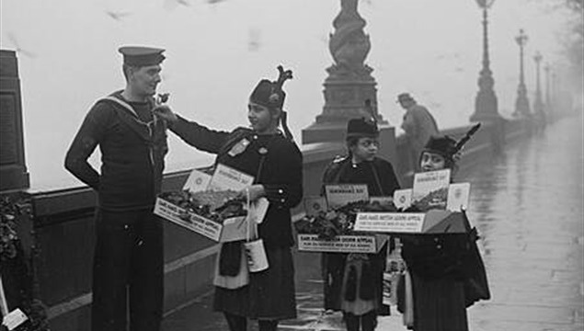
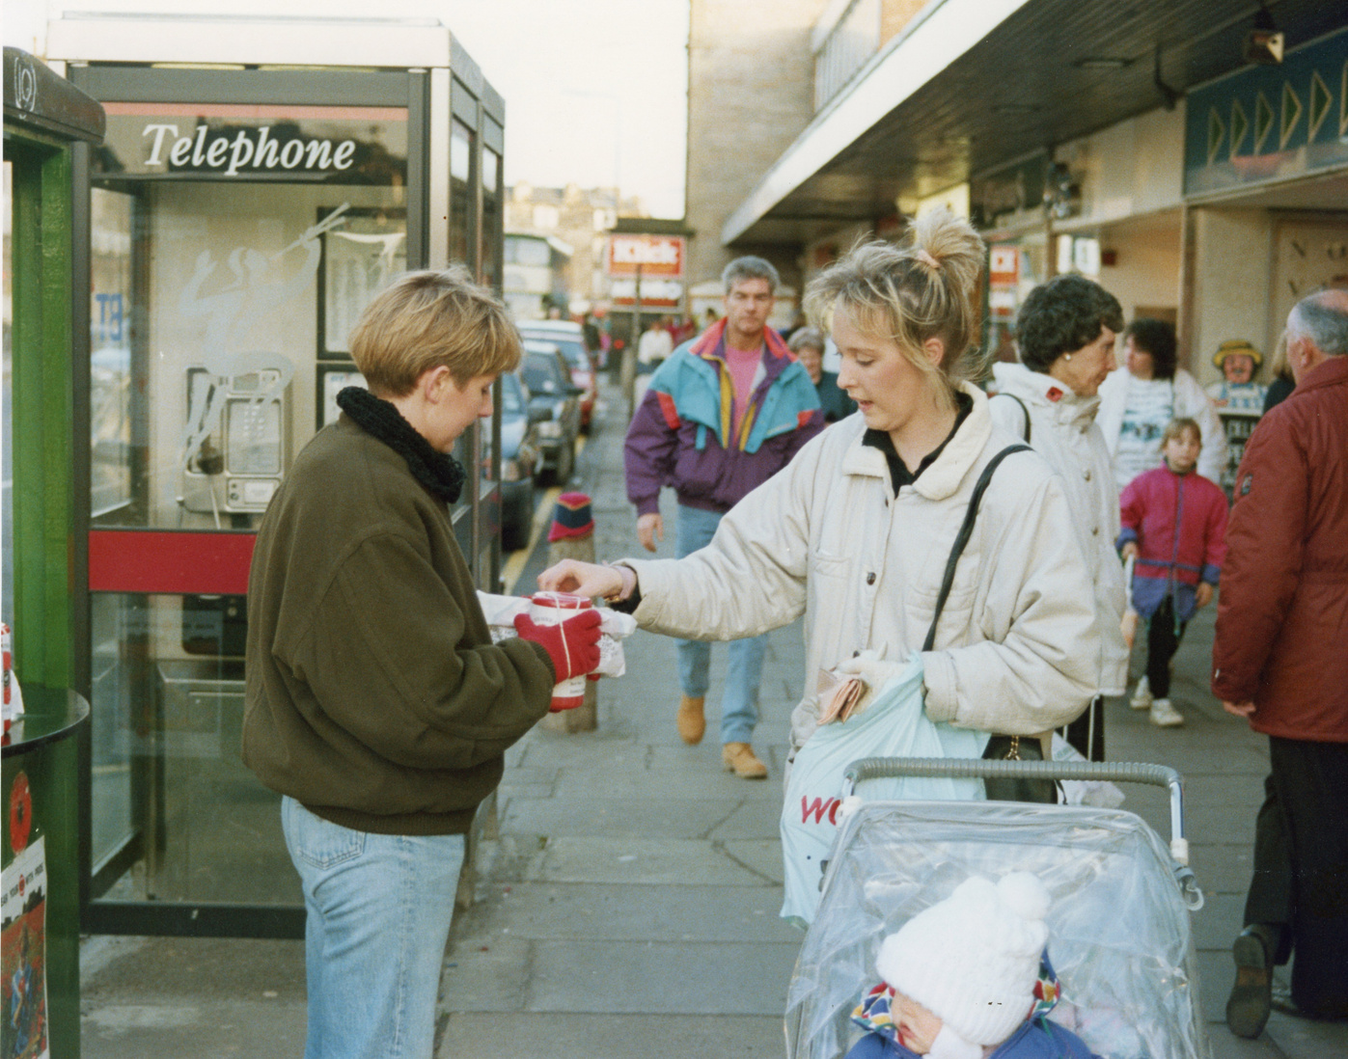
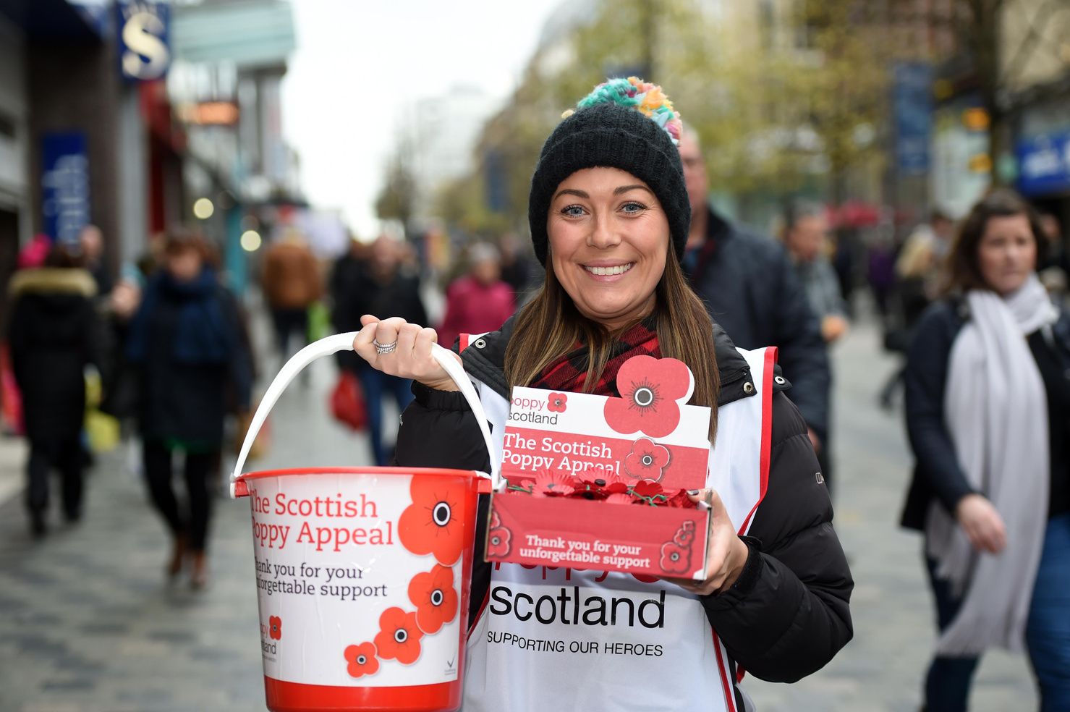
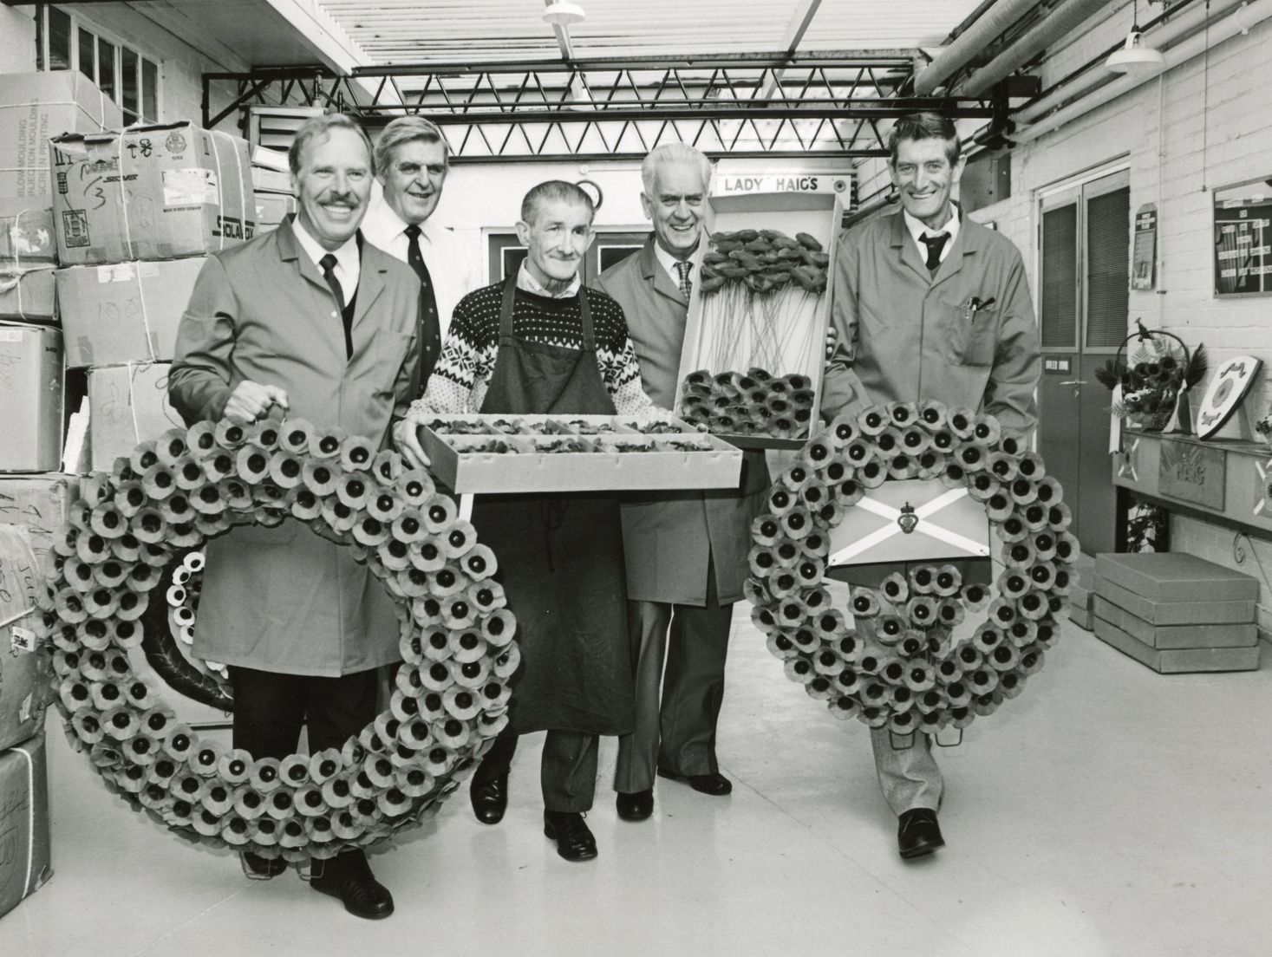
The Poppy Appeal
  The first poppies made of cloth were sold in Britain on 11th November 1921, raising £106,000 for war veterans.
  This was the first Poppy Appeal.
  The Poppy Appeal still runs today.
  The money raised from Poppy Appeal is used to support veterans and their families.

Slide 3
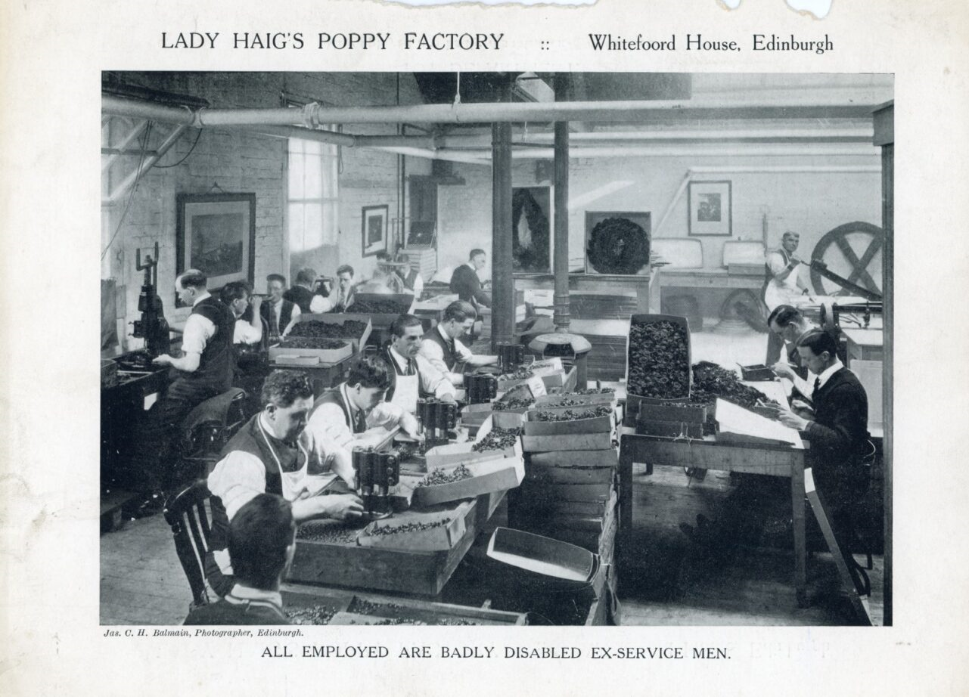
Poppies in Scotland
  The poppies were being made in a factory in England,
  However, demand for poppies was so high that not enough of the poppies were reaching Scotland.
  In 1926 Lady Dorothy Haig set up the Lady Haig’s Poppy Factory in Edinburgh to make poppies exclusively for Scotland.

Slide 4
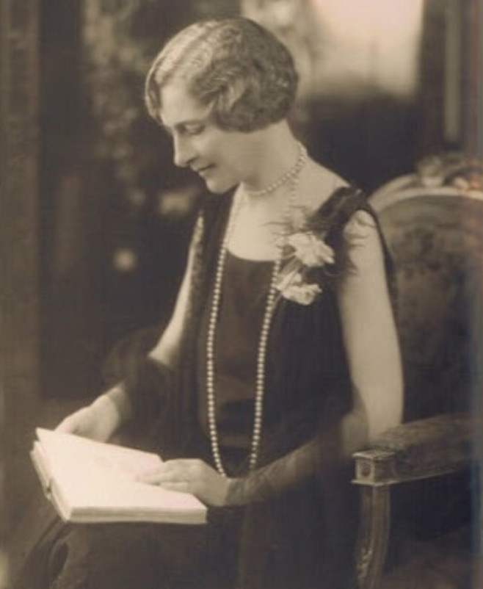

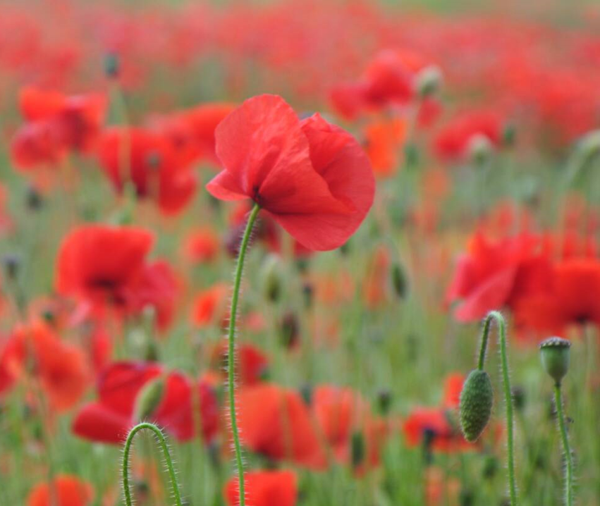
A Different Design
  Lady Haig chose a design that was botanically correct for the Scottish poppy.
  The design of the Scottish poppy was to include four petals and no leaf.
  This is the design that continues to be used today for the Scottish poppy.

Slide 5
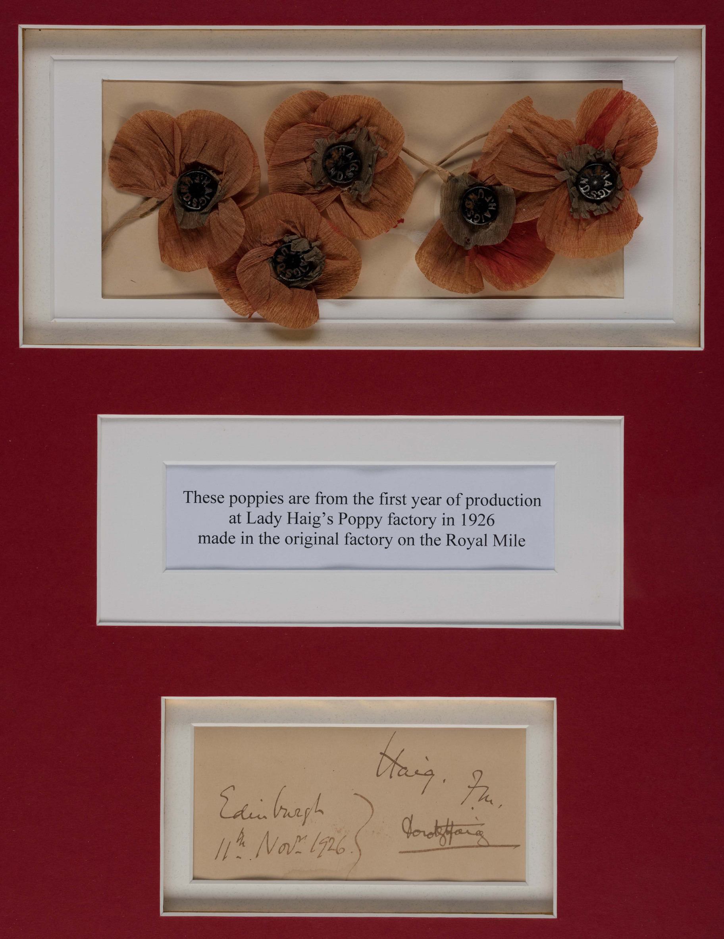
In the Beginning
In the beginning, the Scottish poppies were made by just two ex-servicemen using a pair of scissors and some tissue.

Slide 6
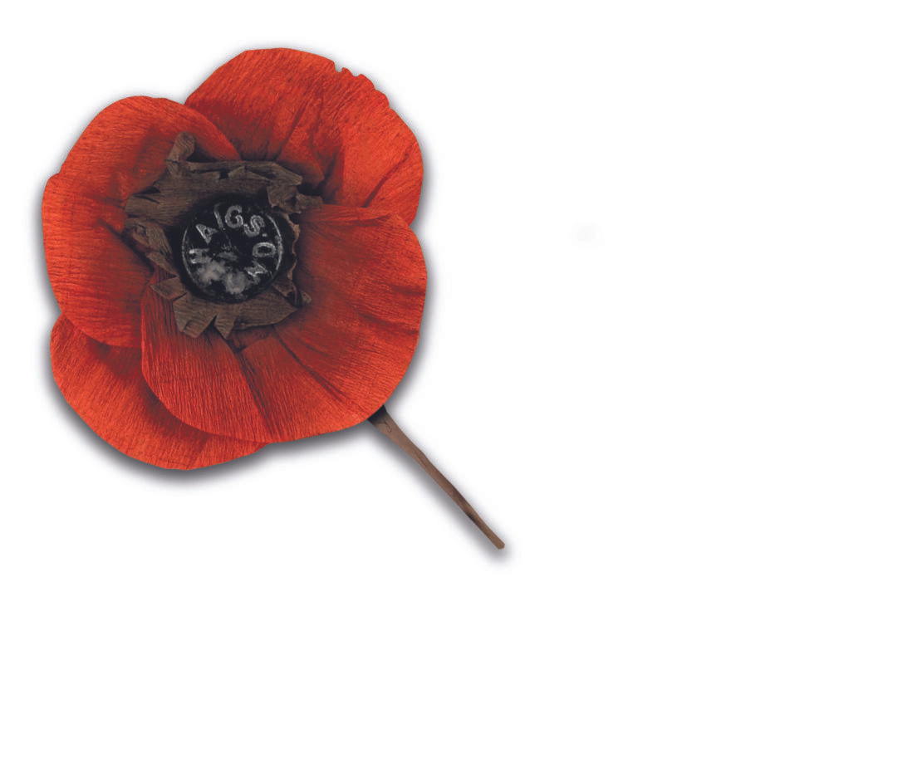
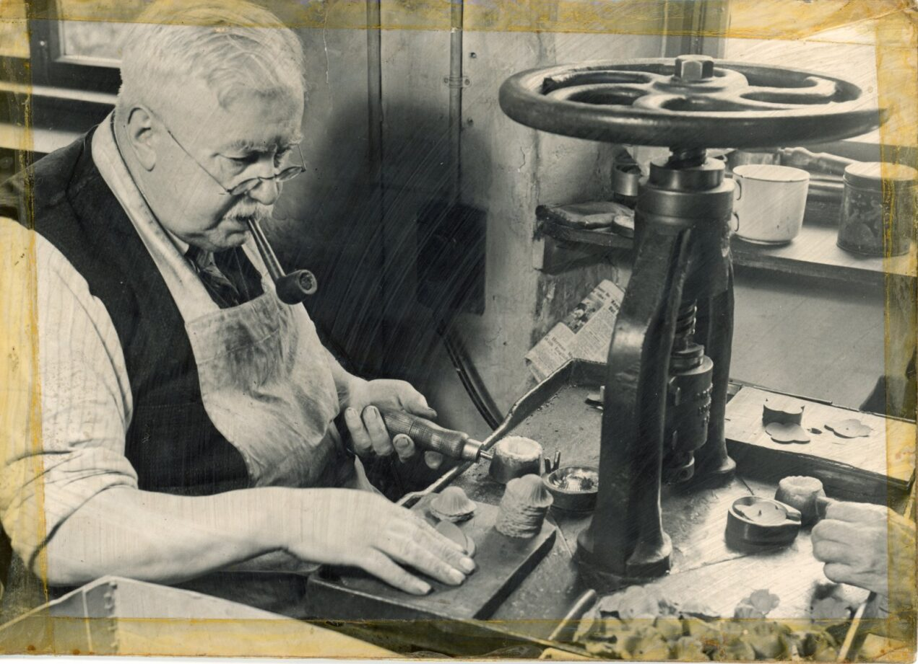
Poppy Production
The factory continued to grow and by the 1930's 117 ex-servicemen worked there.
The production of poppies continued using a variety of materials such as
silk, cloth and paper.

Slide 7
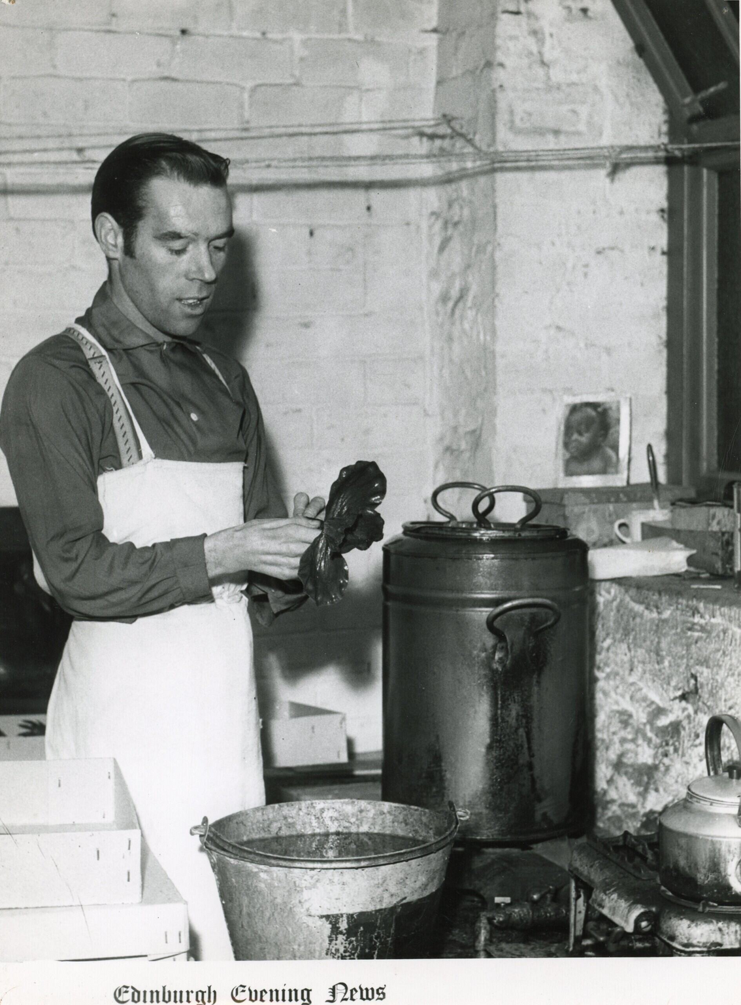
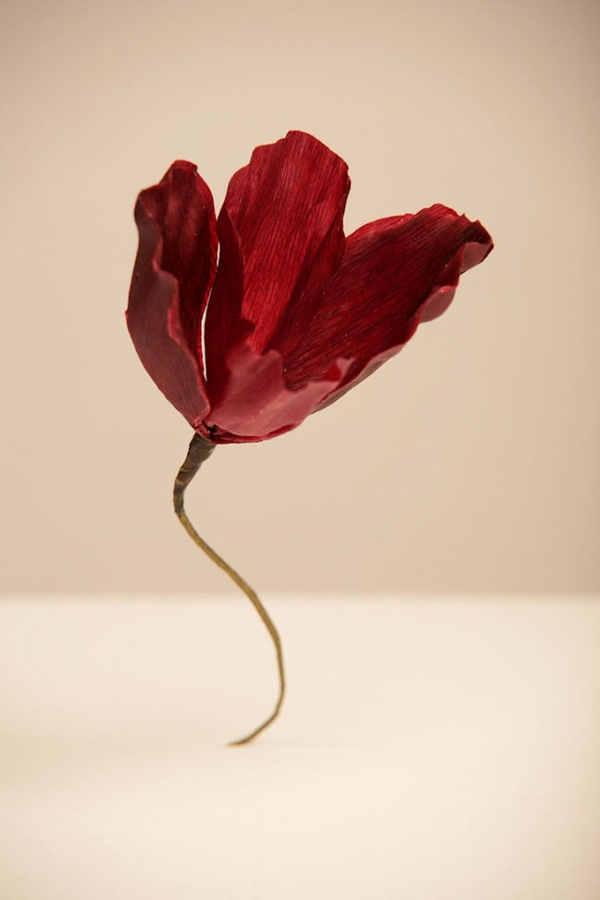
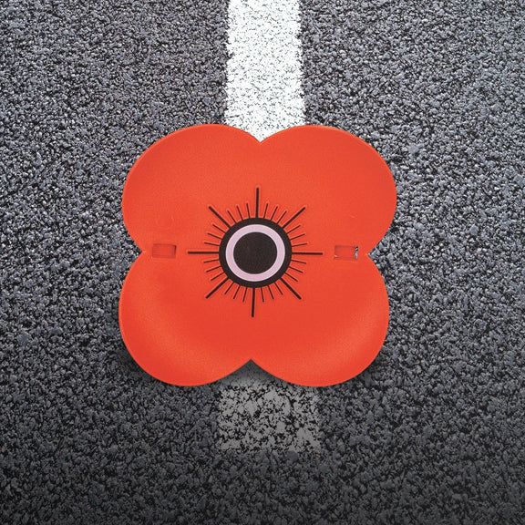
Car Poppies
  The 1930's also saw the introduction of car poppies.
  These poppies were dipped in wax.
  Whilst no longer made in Lady Haig’s Poppy Factory, Poppyscotland still sell car poppies to this day.

Slide 8
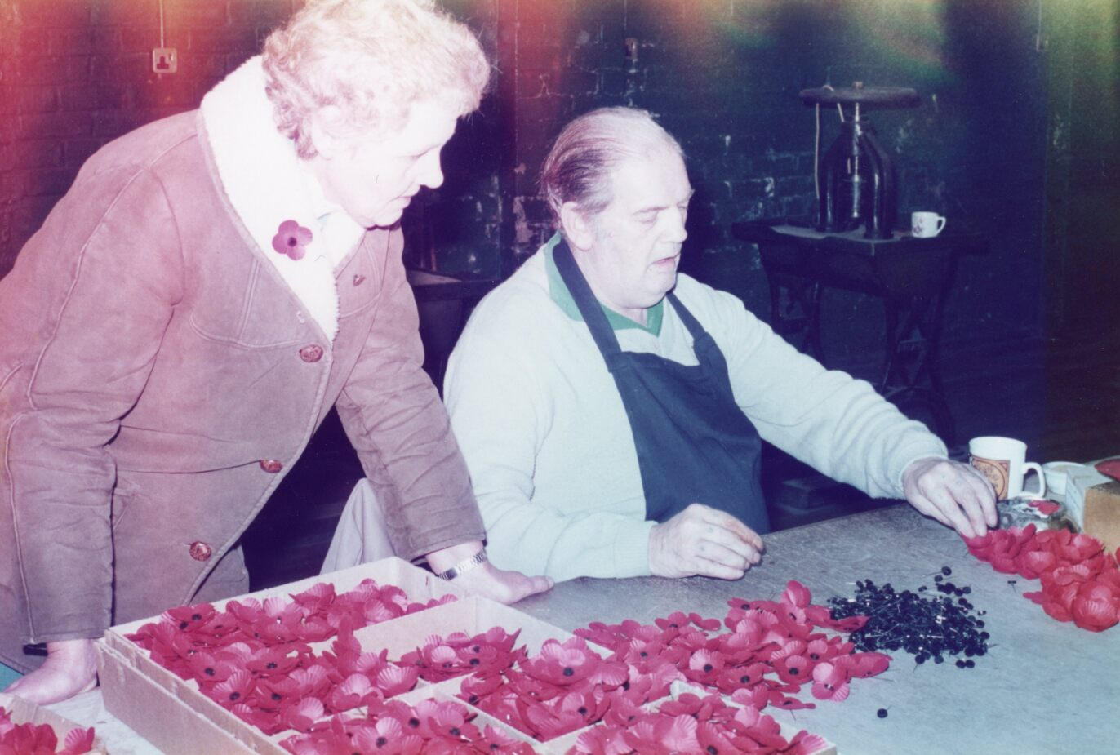
The Lapel Poppy
In 1955 the standard lapel poppy was introduced.
This design is very similar to the design we know and recognise today.

Slide 9
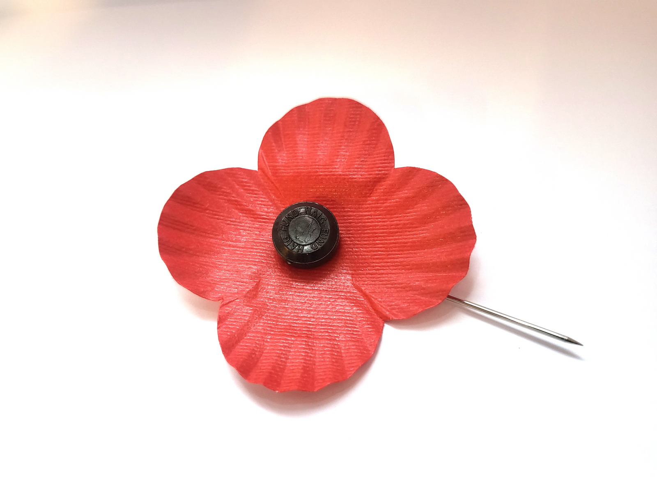
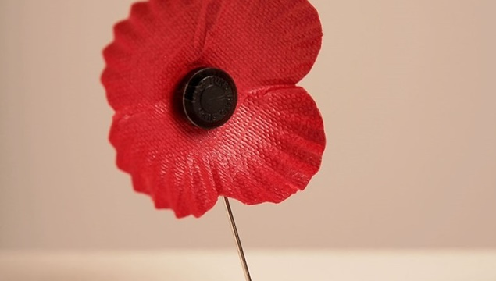
A Poppy with a Pin
Production of the Scottish pin poppy was discontinued in 2007. This poppy had a pin and the words Haig Fund on the button.

Slide 10
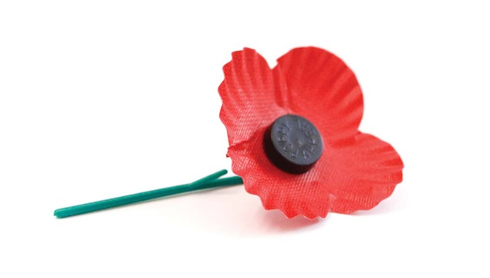
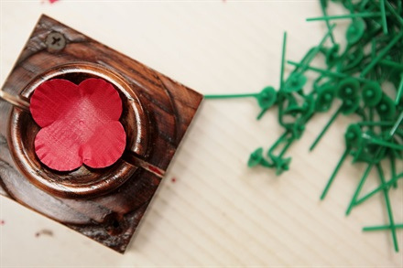
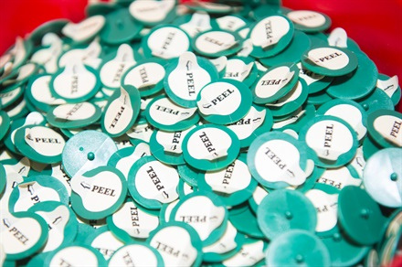
Green Stem
  The new design for the lapel poppy included a green plastic stem and the words Poppy Appeal on the button.
  An adhesive stick-on version of this was also made.

Slide 11
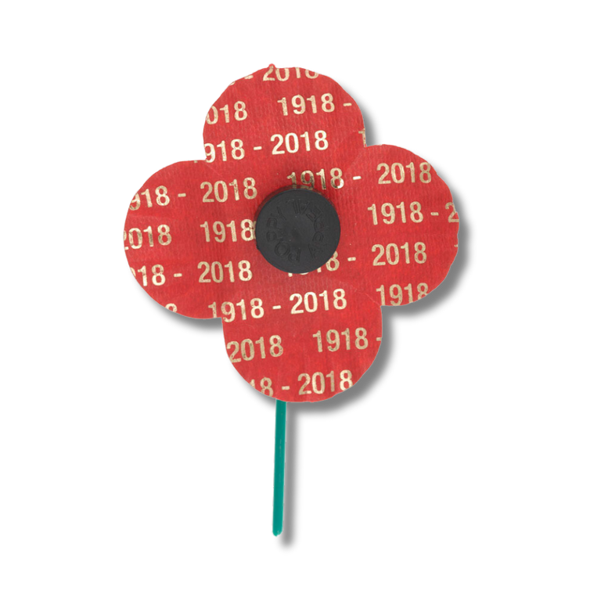
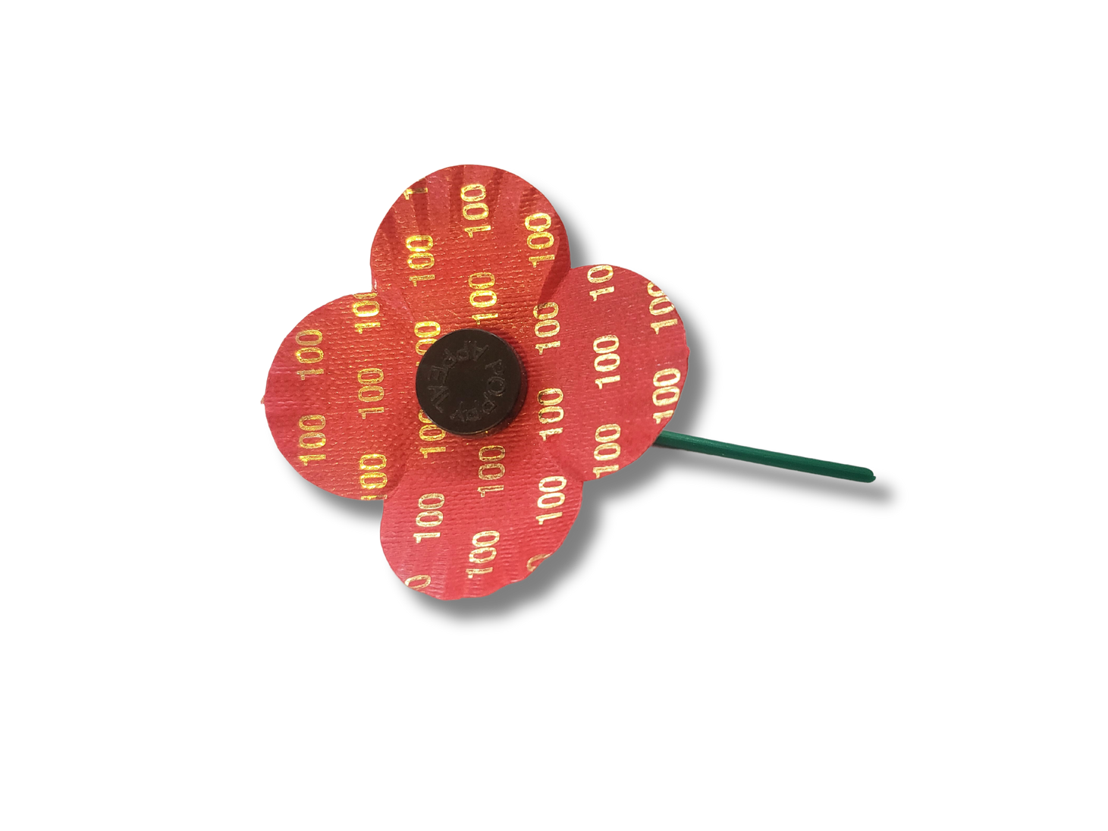
Special Editions
  Two special editions of this lapel poppy were released which featured gold numbers.
  One in 2018 to mark the centenary of end of the First World War.
  Another in 2021, to mark 100 years of the Poppy Appeal.

Slide 12
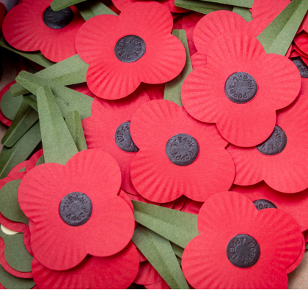
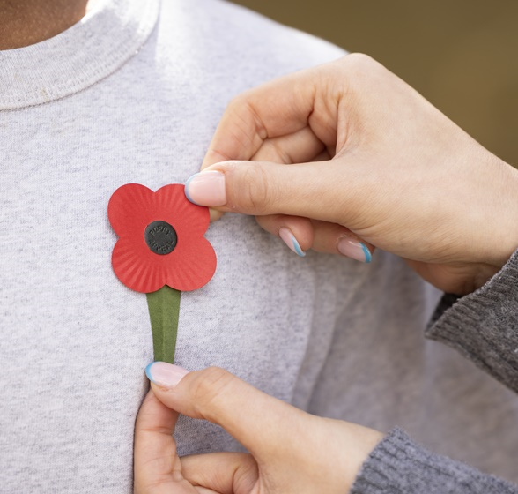
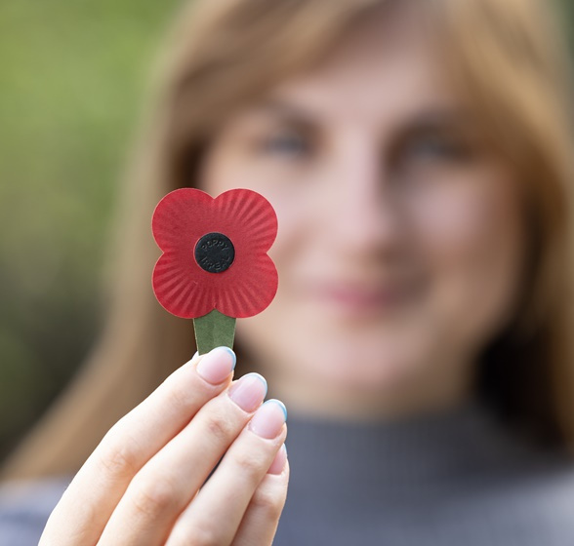
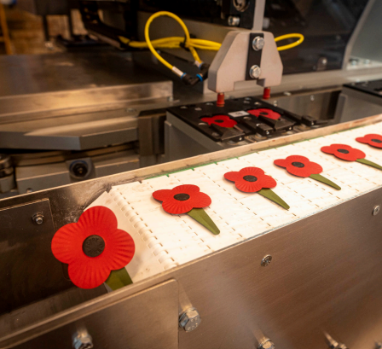
Plastic-free Poppy
  In 2023 the plastic-free poppy was introduced in a move to be more sustainable.
  The paper used in this poppy is a bespoke blend. 50% of the fibres used in this paper are made from the waste production of coffee cups.
  The plastic-free poppy keeps the iconic four petal design whilst reducing Poppyscotland’s impact on the environment.

